Slide 1
EDU GRAPH-API Demo Script
Expertise in Microsoft's Azure, Office 365, and SharePoint platforms

Slide 2
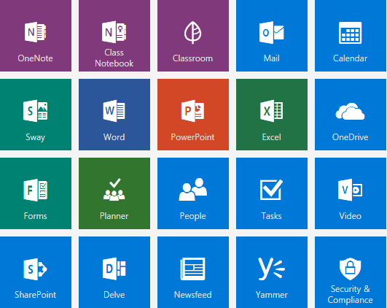
Agenda
Admin Login Authentication Flow
Local Login Authentication Flow
O365 Login Authentication Flow
ALL SCHOOLS
SCHOOL CLASSES
CLASS DETAILS
Sync Data With Web Job

Slide 3
Admin Login Authentication Flow

Slide 4
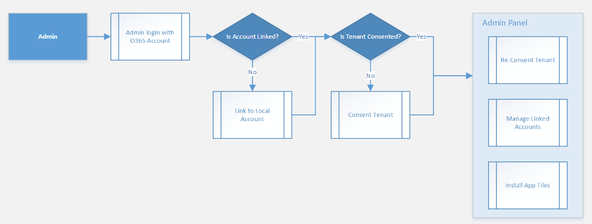
Admin Login Authentication Flow

Slide 5
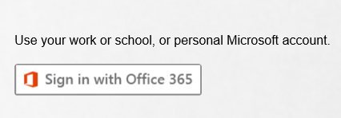
Admin Login with O365 Account
Go to site login page.
Click “Sign in with Office 365” button.
Login with Admin account.

Slide 6
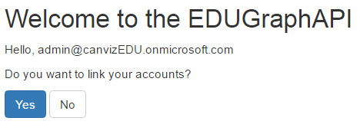
Admin Linked to a Local Account?
Is Admin linked to a local account?
Yes, go to link account page.
No, go to schools page.

Slide 7
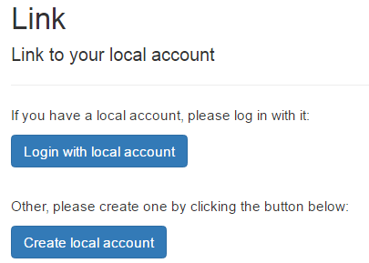
Link Admin to a Local Account
If you have a local account, login and then link.
If you do not have a local account, create and link.

Slide 8
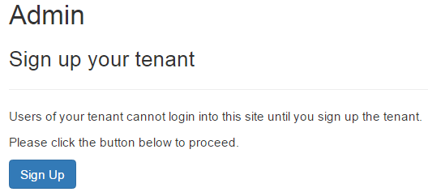
Sign Up Tenant
Click “Sign Up” button to sign up the tenant.
After sign up complete go to Admin panel.

Slide 9
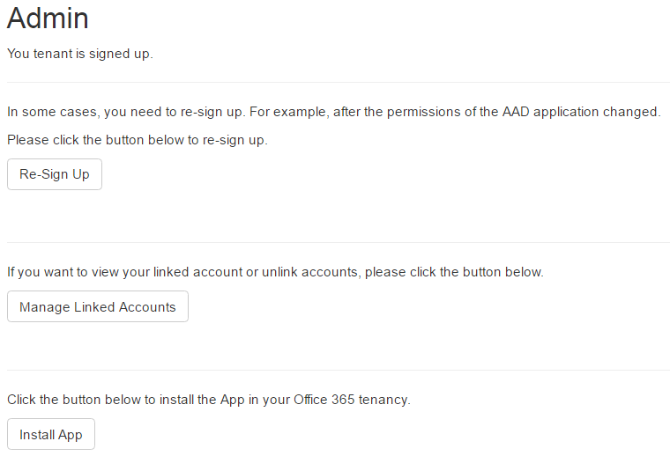
Admin Panel
Click “Re-Sign Up” button to re-sign up the tenant(need to login again).
Click “Manage Linked Accounts” button to view/unlink account.
Click “Install App” button to install the App in Office 365 tenancy.

Slide 10
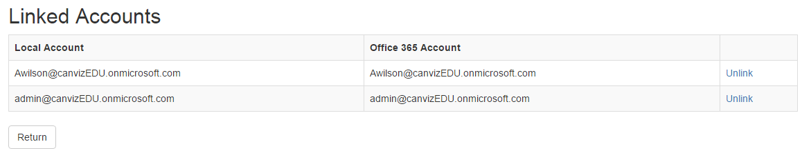
Admin Panel - Manage linked accounts
All linked users will display here.
Click “Unlink” link to unlink a user.

Slide 11
Local Login Authentication Flow

Slide 12
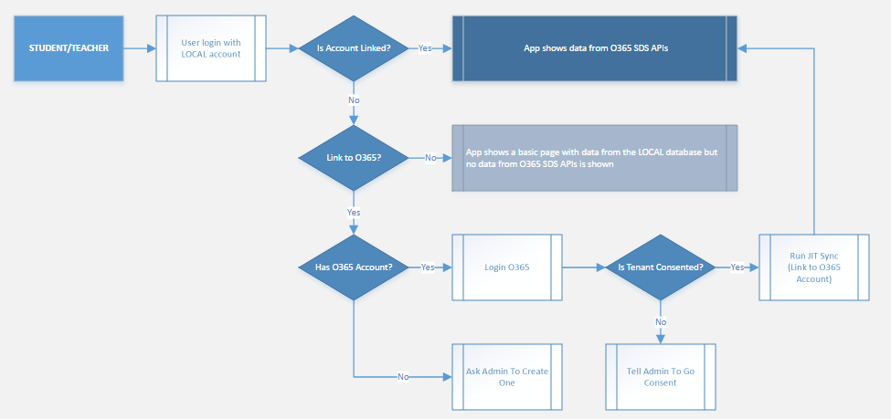
Local Login Authentication Flow

Slide 13
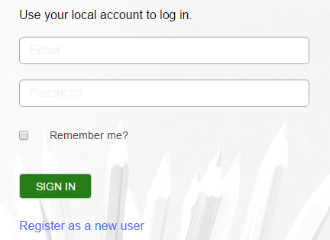
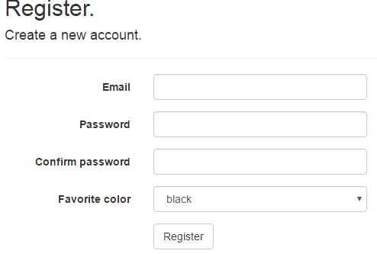
Create Local Account
Go to site login page and click “Register as a new user” link.
Input fields like “Email”, “Password” etc. and then click “Register” button.

Slide 14
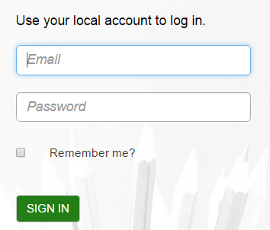
Login with Local Account
Go to site login page.
Input email and password.
Login with local account.

Slide 15
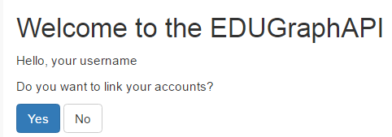
Link Local Account to O365 Account
Click “Yes” button to link account.
Click “No” button will show a basic page and stop.

Slide 16
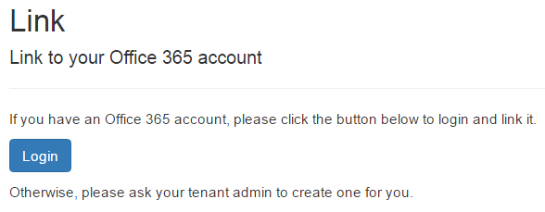
Login to O365 and Link
Click the “Login” button and login to O365.
After login succeed it will link automatically and then go to all schools page.

Slide 17
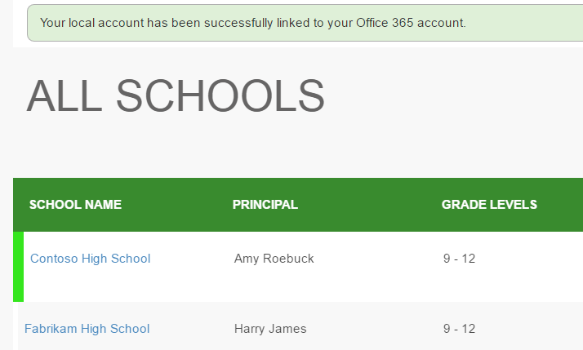
Login succeed
After link succeed it will show all schools.

Slide 18
O365 Login Authentication Flow

Slide 19
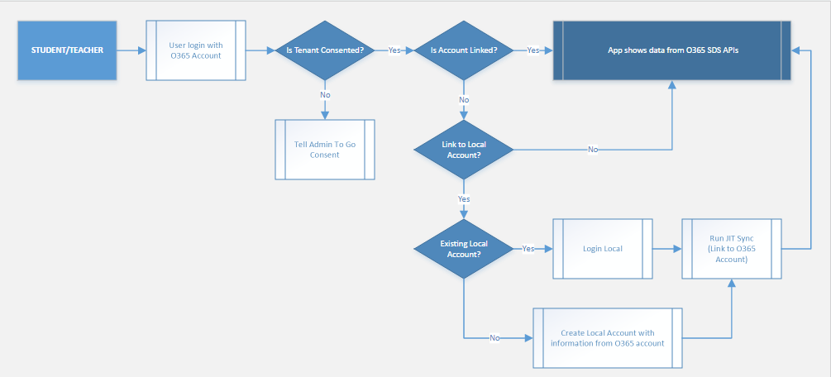
O365 Login Authentication Flow

Slide 20
Login with O365 Account
Go to site login page.
Click “Sign in with Office 365” button.
Login with O365 account.

Slide 21
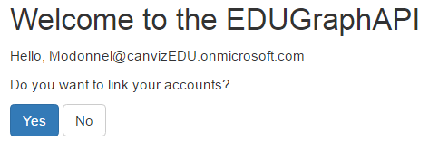
Link O365 Account to Local Account
Click “Yes” button to link account.
Click “No” button will go to all schools page

Slide 22
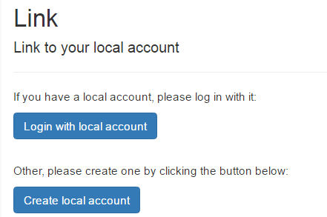
Login to Local and Link
Click the “Login with local account” button to login with local account.
Click the “Create local account” to create a local account and then link.

Slide 23
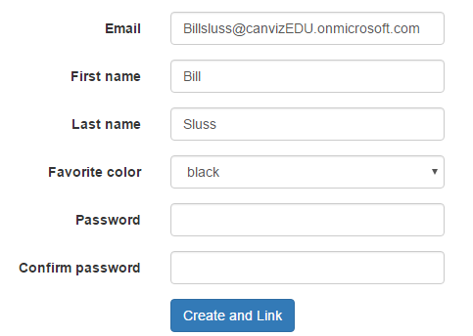
Create Local Account and Link
Input fields like “Favorite color”, “Password” and “Confirm Password”. Select “Favorite color”.
Click “Create and Link” button to create a new local account and then link.

Slide 24
ALL SCHOOLS

Slide 25
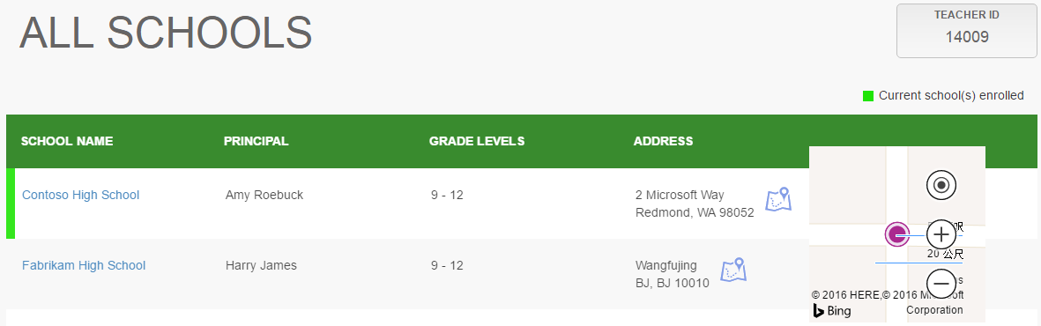
ALL SCHOOLS
Login with a teacher/student account and go to all schools page.
Display teacher/student’s id on top right corner.
Current school(s) enrolled will be marked with green color.
Click school name can go to classes page.
Click Bing map icon to show map of selected school.

Slide 26
SCHOOL CLASSES

Slide 27
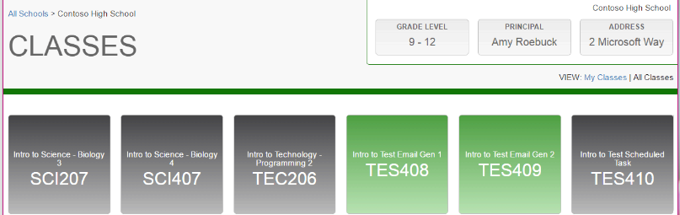
SCHOOL CLASSES
All classes will display on school classes page.
My classes will be high lighted with green color.
Classes that not mine will be high lighted with gray color.
Hover on one class will pop up class detail window.
Click on green high lighted classes will go to class detail page.
Click “My Classes” or “All Classes” link to switch view.

Slide 28
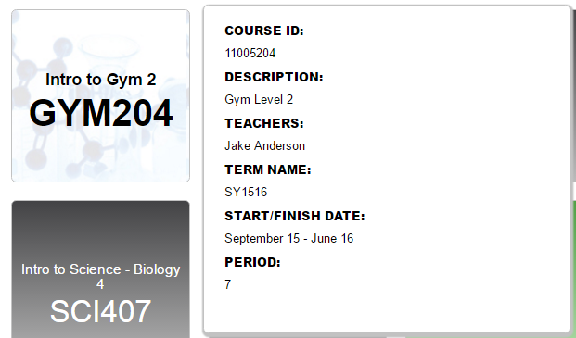
Class detail information
Hover on a class tile will popup class detail window.

Slide 29
CLASS DETAILS

Slide 30
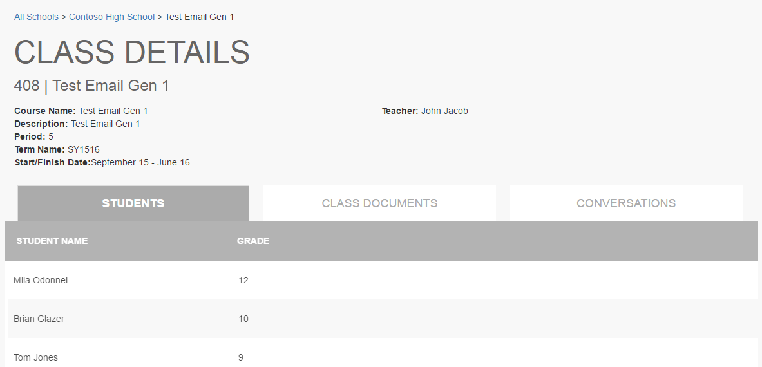
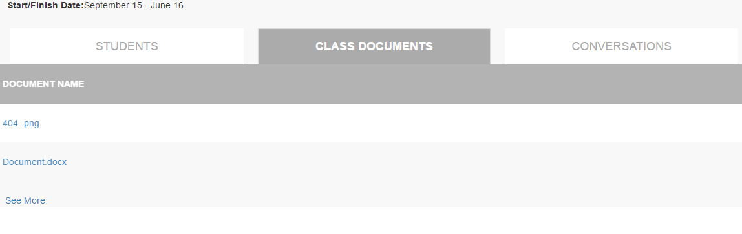
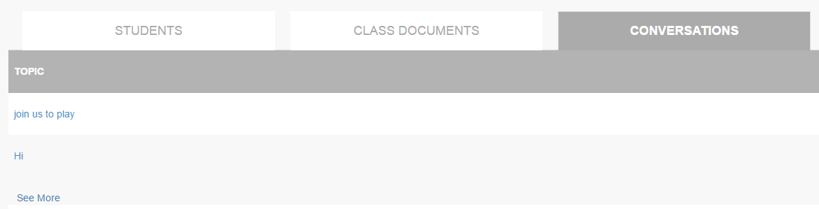
Class detail
Class detail will show on this page.
There are 3 tabs with students, class documents and conversations. Click each tab to see detail information.

Slide 31
Sync Data With Web Job

Slide 32
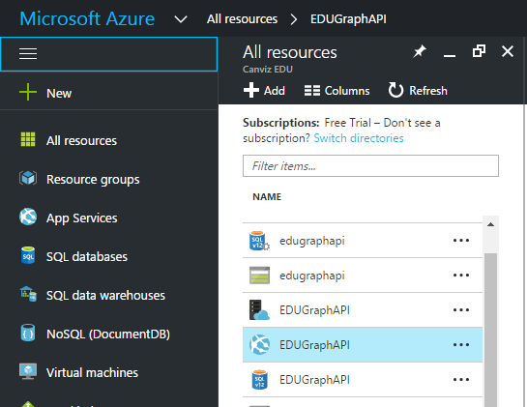
Sync Data With Web Job
Got to https://portal.azure.com and login with admin account.
Click “All resources” on left side of the page. All resources will be displayed.
Click the App services named “EDUGraphAPI”.

Slide 33
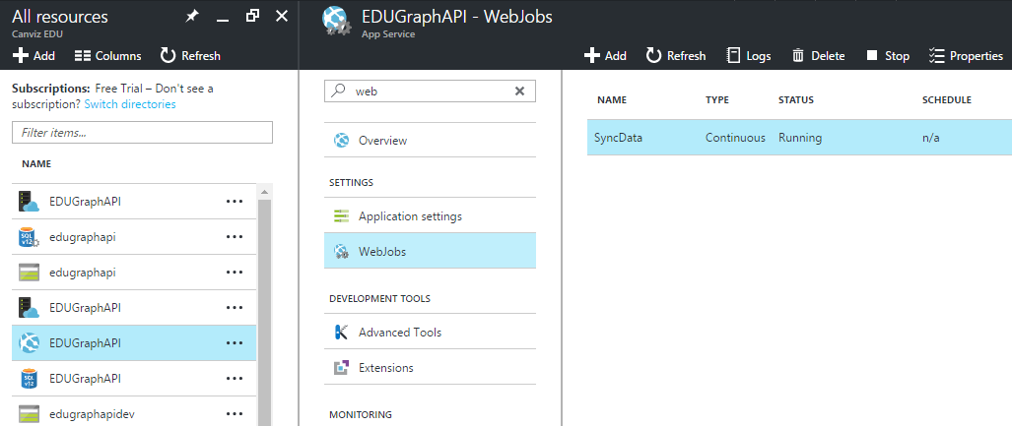
Web Jobs
Click “Web Jobs” under “Settings” group.
Select the job named “SyncData” and then click “Logs”

Slide 34
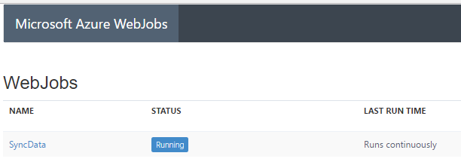
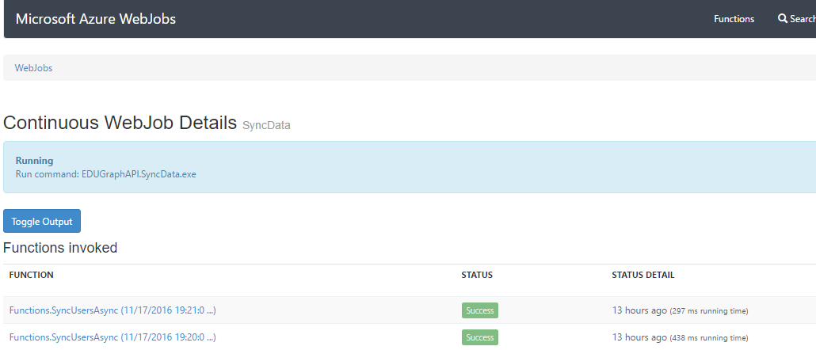
Web Job Logs
Click “SyncData” link to see Log details.
On Log detail page click “Toggle Output” button to show Log details.

Slide 35
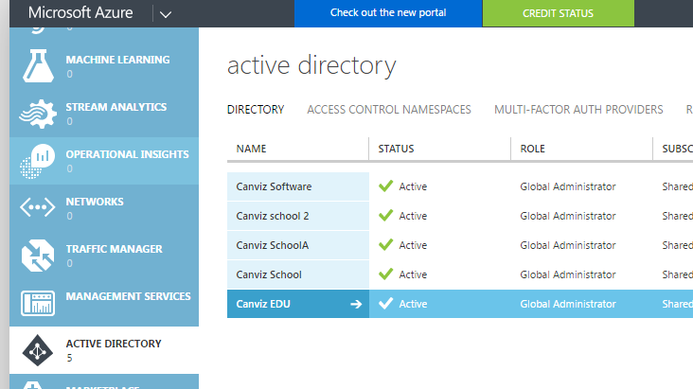
Update AD User Information
Go to https://manage.windowsazure.com/ and login with admin account.
Click “ACTIVE DIRECTORY ” on left navigation.
Click the AD named “Canviz EDU”.

Slide 36
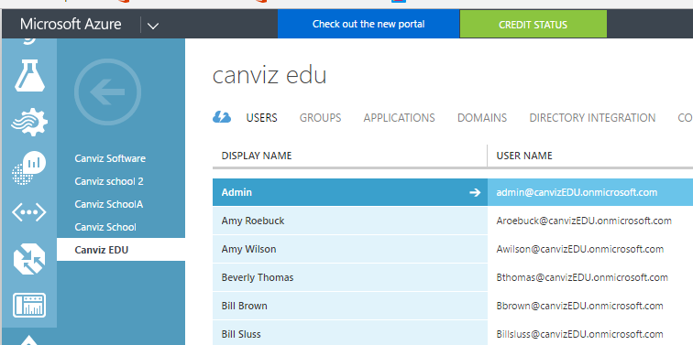
Update AD User Information
Click “Users” and all uses list in “Canviz EDU” will display here.

Slide 37
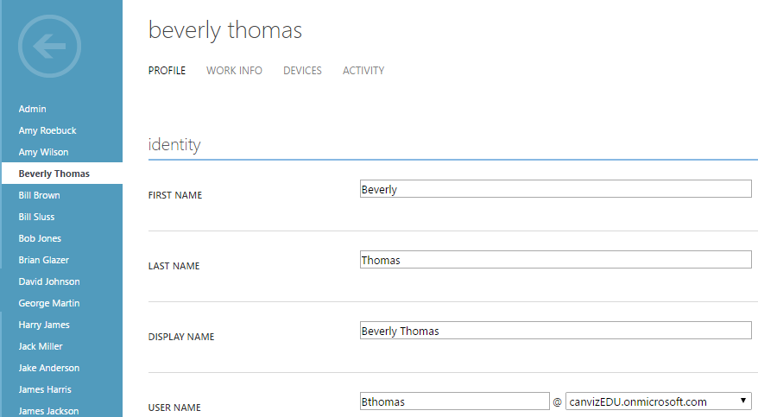
Update AD User Information
Click one user and open edit page.
Update user information like “First name” or “Last name”.
Save change.

Slide 38
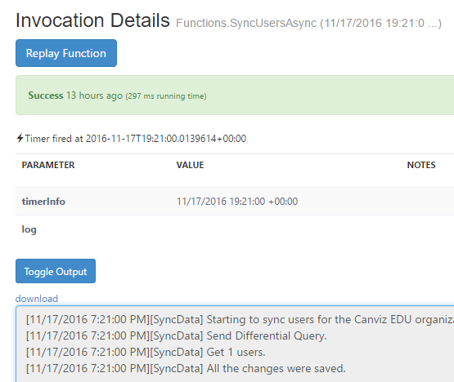
Check Web Job Sync Result
Go back to web job log detail page.
After about 1 minutes refresh the page.
Click the latest function invoked and open detail page.
Click “Toggle Output” button.
It will show log that tells one item updated.

